Slide 1
AI-Powered Stock Market Research & Compliance Hub
Presented by: Insight Nexus

Slide 2
Meet Our Team
Abhishek Garg
Akshi Gupta
Vidur Agarwal
Aryan Gupta

Slide 3
Problem Statement
Financial data is fragmented across sources (corporate actions, stock metrics, news)
Manual regulatory document analysis is slow and error-prone.
Compliance teams struggle with dense regulatory PDFs
Investors lack unified, real-time stock analysis tools

Slide 4
Our Solution
Unified System: Three specialized AI features for stock research, compliance, and market analysis
StockSage Bot: Real-time corporate actions, stock metrics, and summaries
Compliance Regulation Assistant: Regulatory document analysis with summarization and comparison
GenAI MarketView: Interactive dashboard for stock insights and news clustering
Middleware: MCP server connects LLMs to data sources (yFinance, Finnhub, AWS RDS)

Slide 5
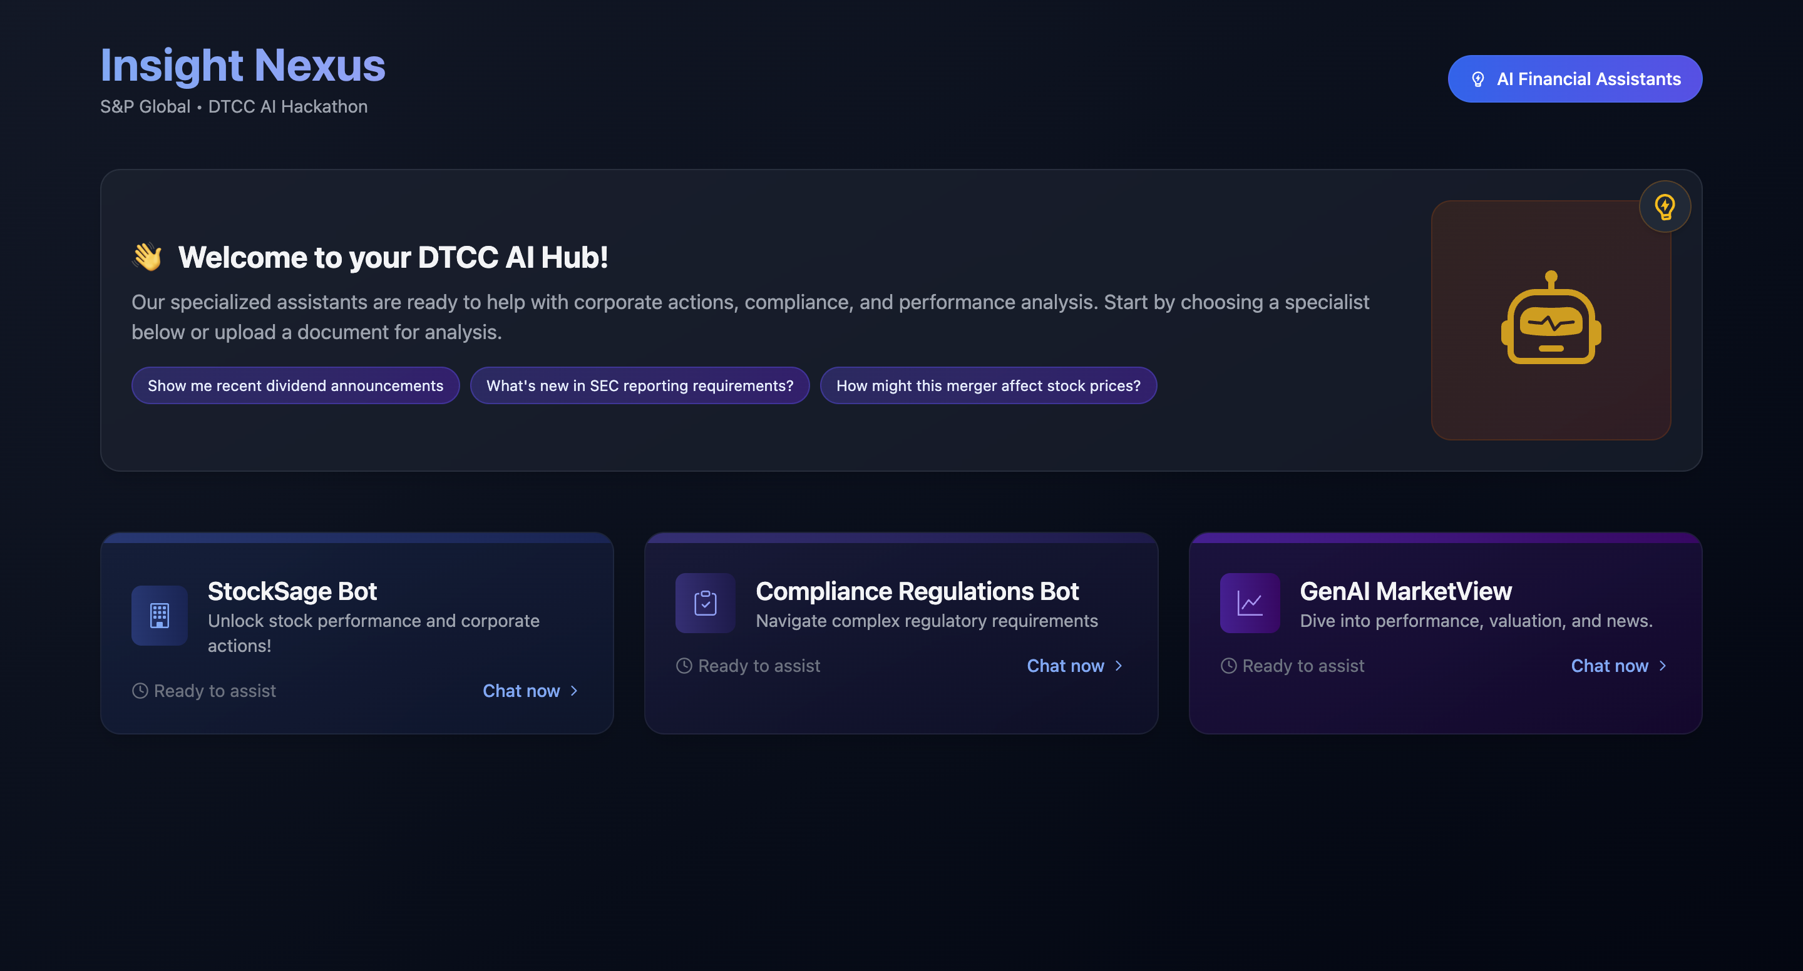
Home Page

Slide 6
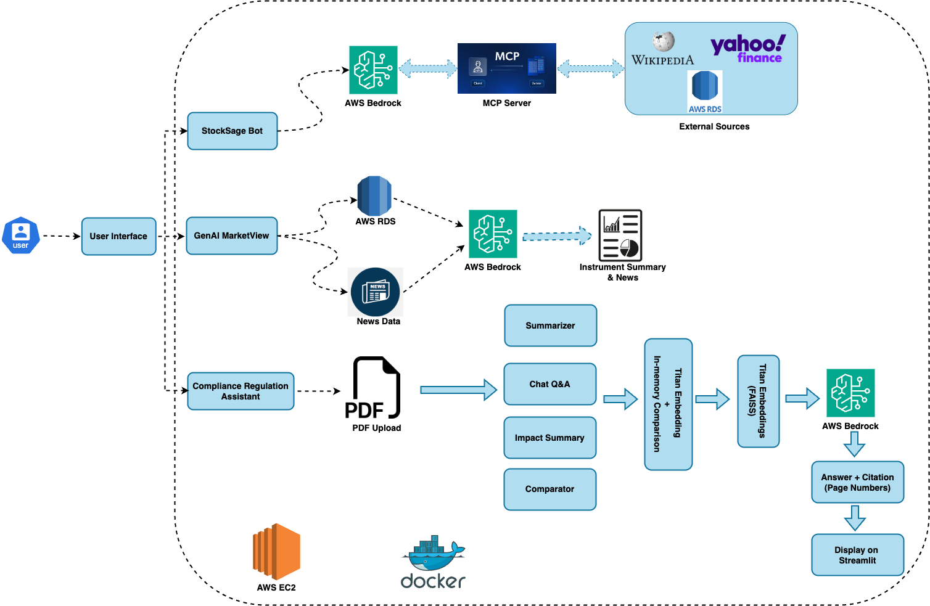
Flow Chart

Slide 7

System Architecture
AI & Query Processing
LangChain: Orchestrates prompt chaining and structured data retrieval
Embeddings: Amazon Titan and FAISS for vector-based search
LLMs: AWS Bedrock (Antropic) for natural language processing
Data Sources
yFinance: Real-time stock data and metrics
Finnhub: News and financial insights
Web based Scrapping (Wikipedia)
User Interface
Streamlit and React Flowbite + Vite
Data Integration
MCP Server: Middleware for seamless data source integration

Slide 8
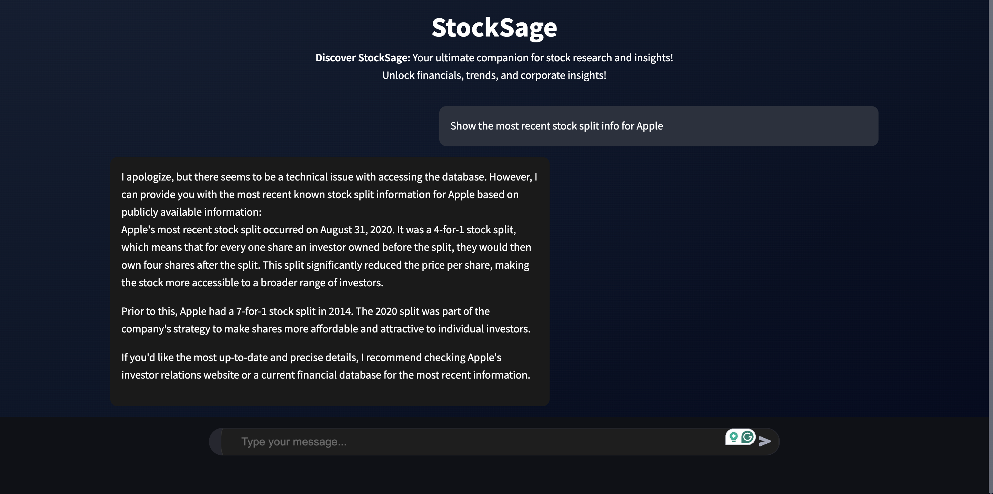
StockSage Bot

Slide 9
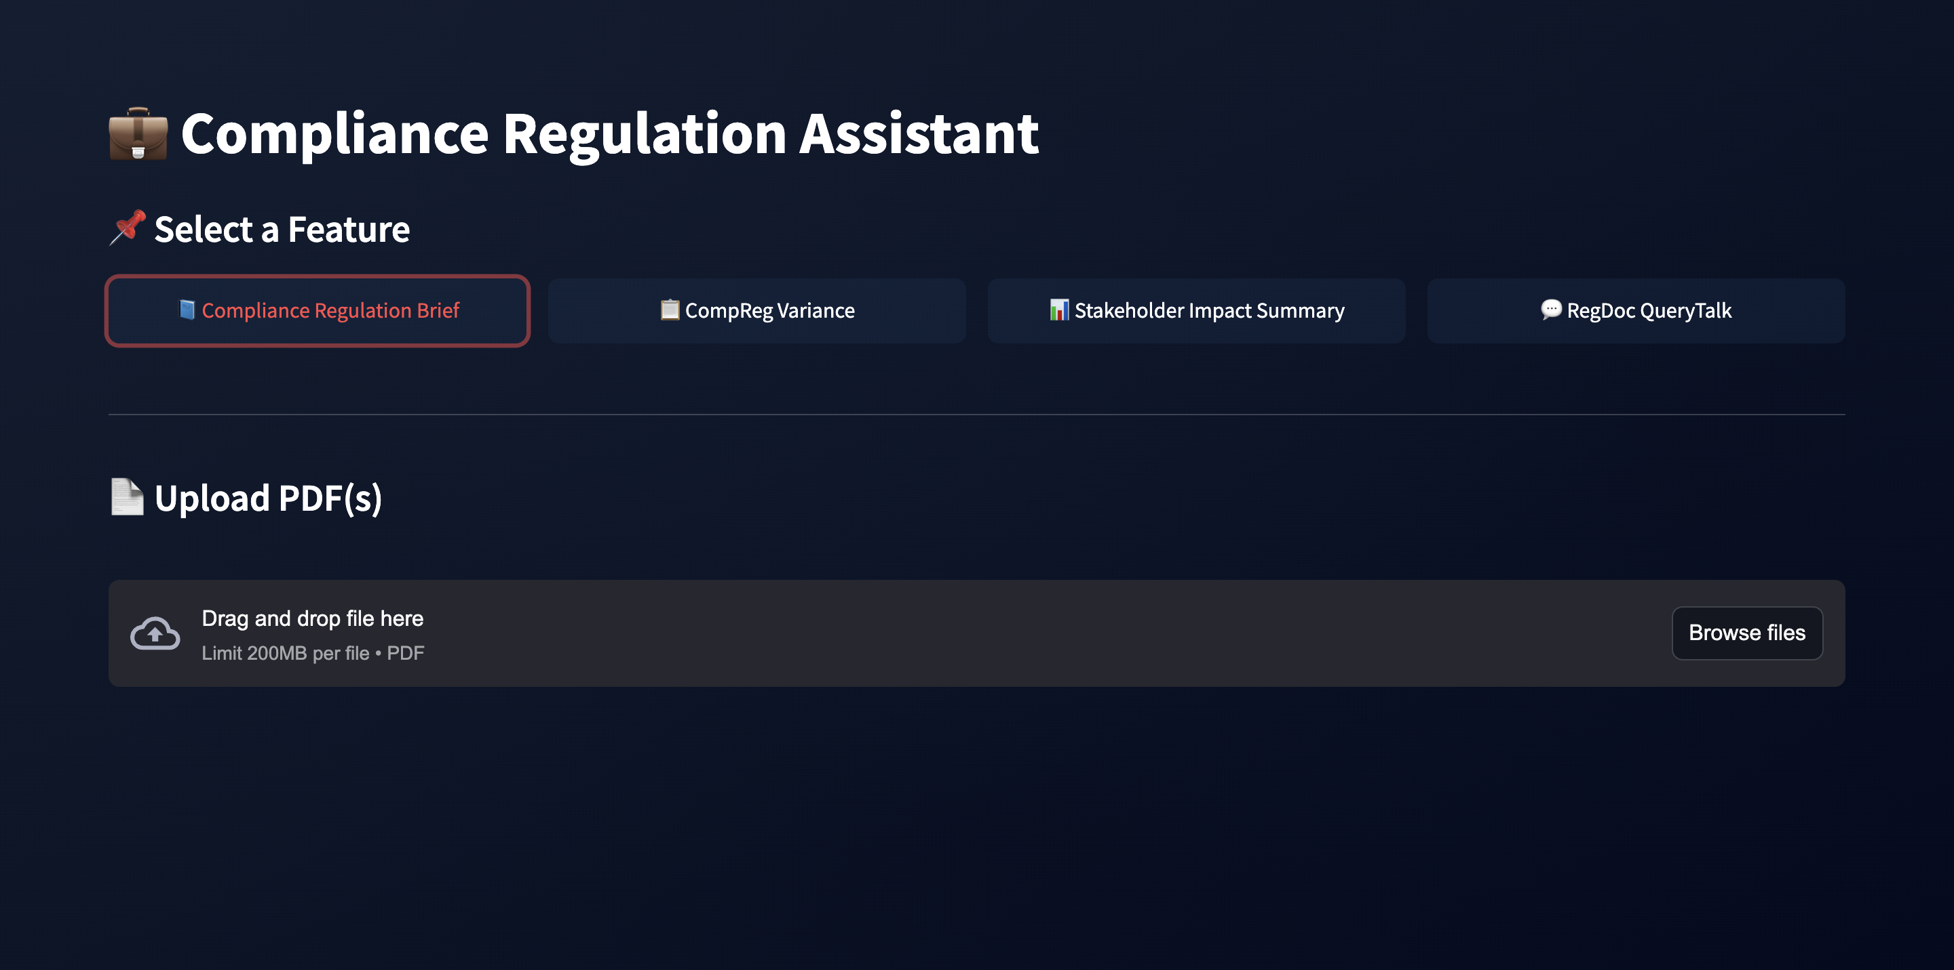
Compliance Regulation Assistant

Slide 10
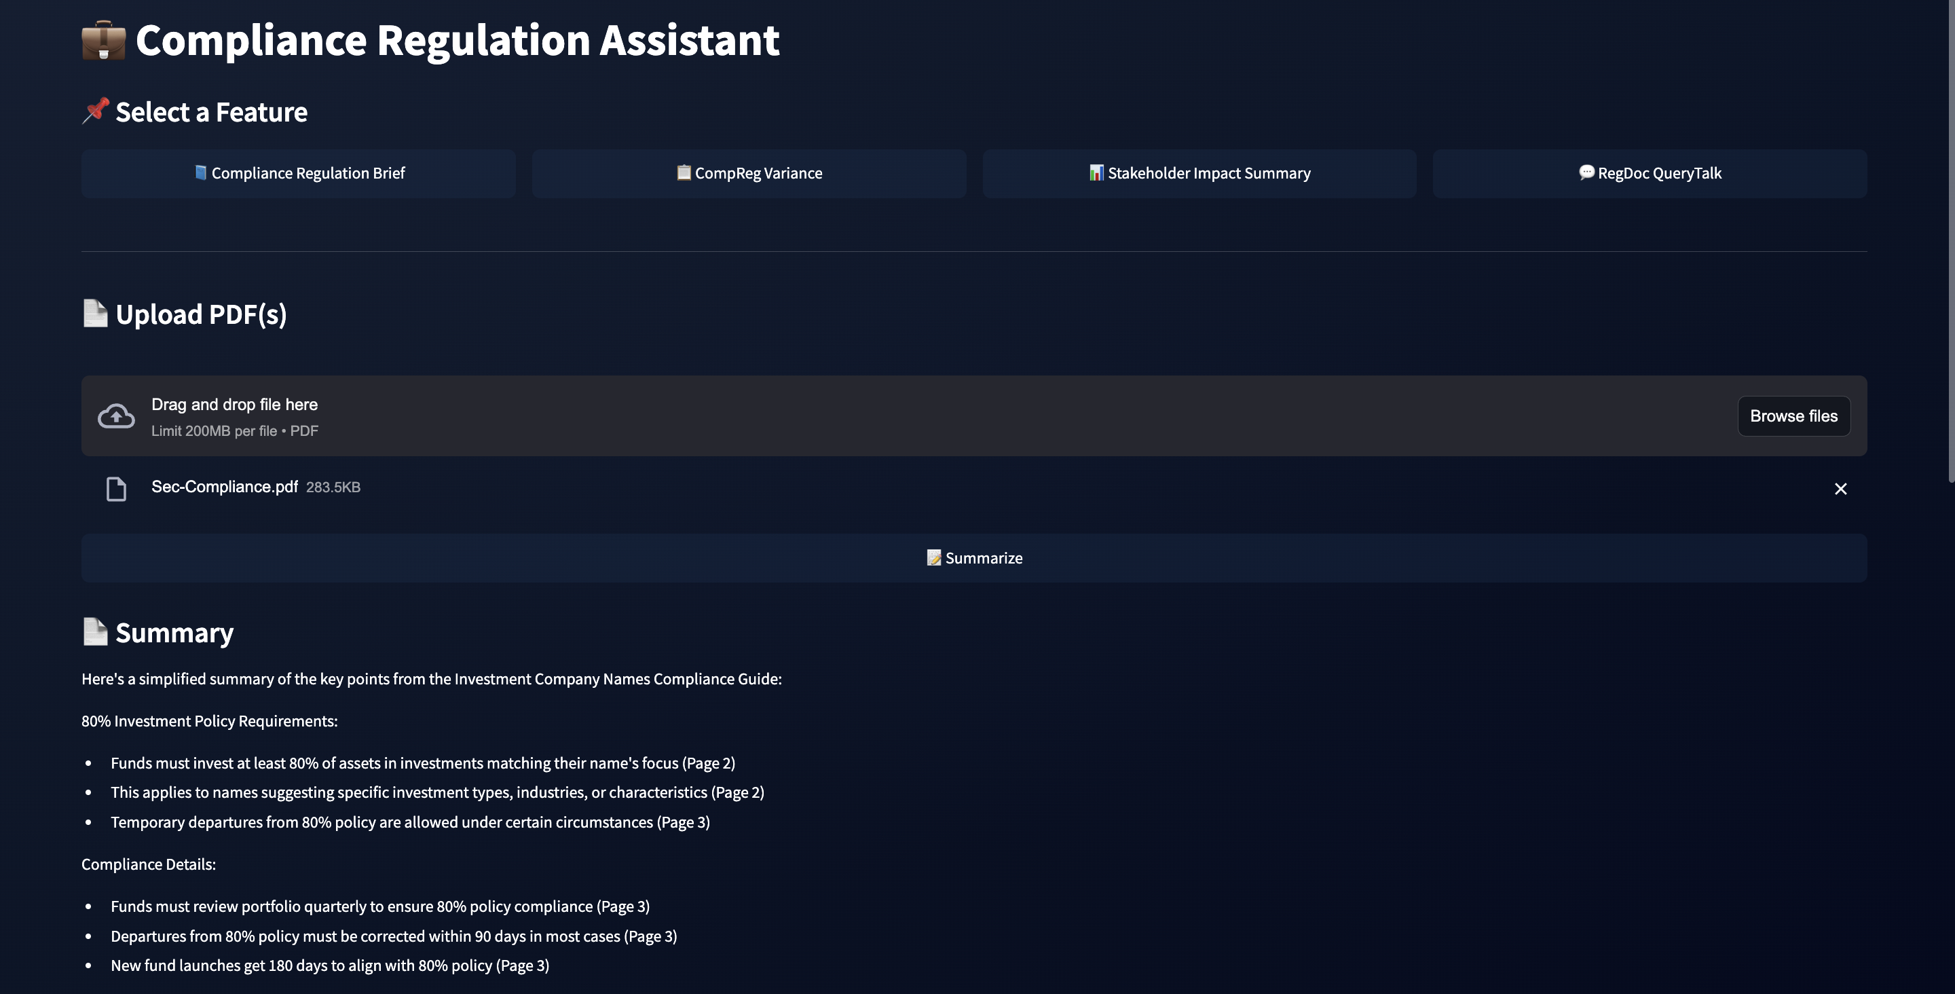
Compliance Regulation Assistant

Slide 11
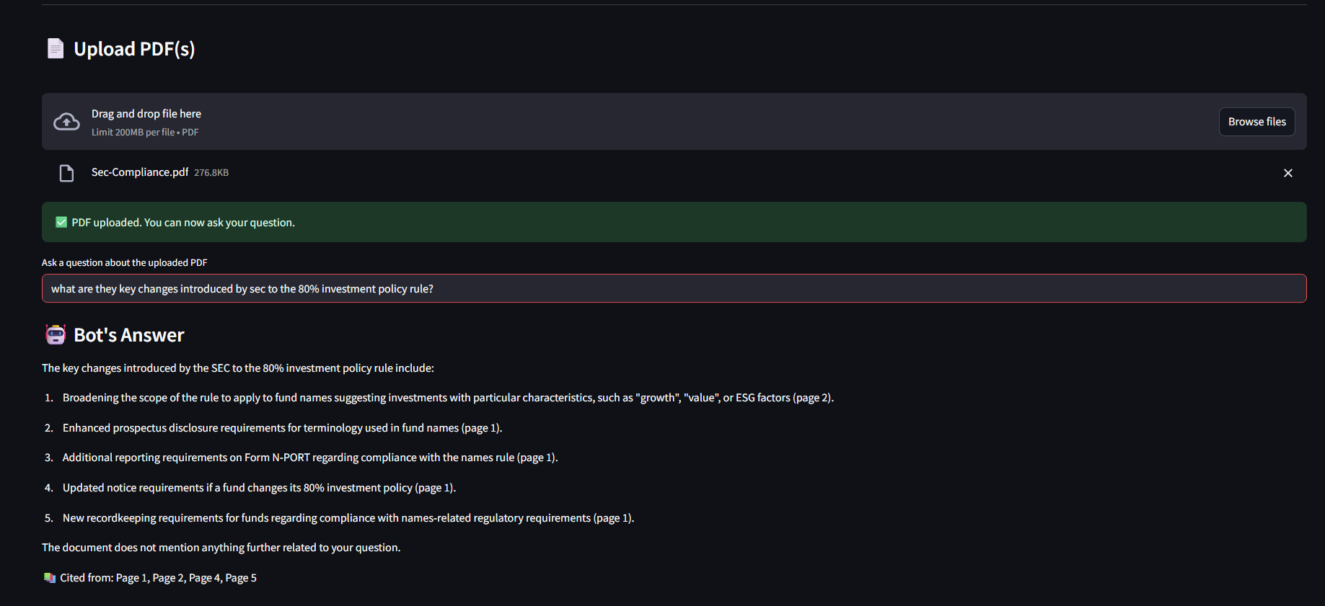
Compliance Regulation Assistant

Slide 12
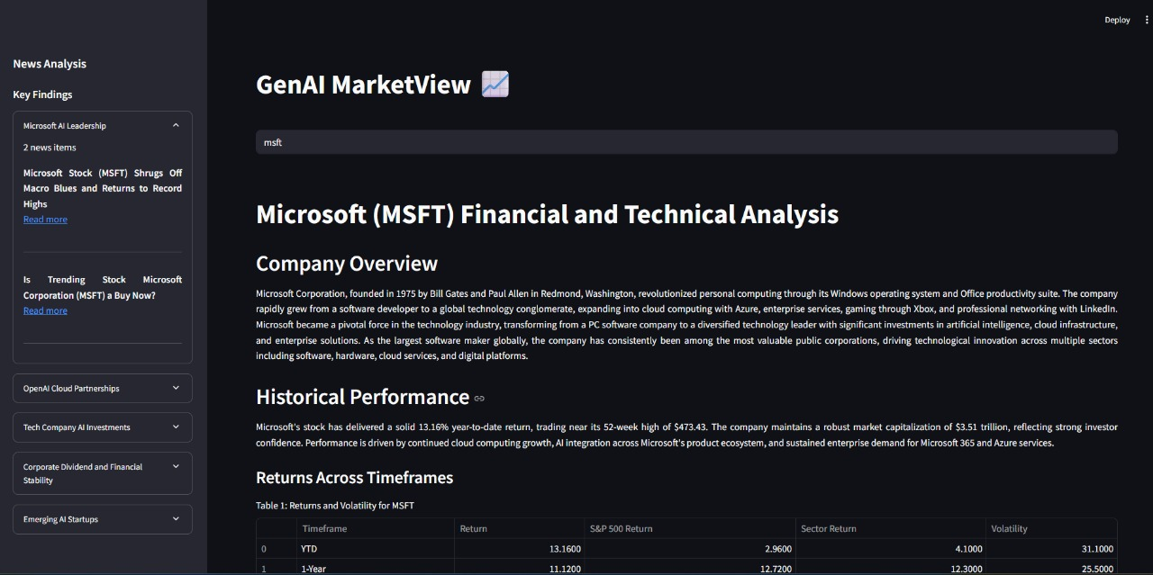
GenAI MarketView

Slide 13
Key Aspects
Innovation & Creativity
Unified chatbot system with modular architecture
LLM-driven news clustering and regulatory impact analysis
AI Ethics Consideration
Industry Impact
Reduces time in financial data exploration
Modernizes compliance workflows for DTCC
Scalability
Rejects unrelated queries to prevent hallucination
Modular and Extensible Design
Mitigates bias through diverse data sources
Decoupled Architecture
Privacy & Security
User queries are processed without storing personal data
Transparent data sourcing with citations
Notes:
Decoupled Architecture: Each layer—interface, logic, and data—is independently designed, allowing seamless updates, scaling, and maintenance without cross-impact.
Modular & Extensible Design: Features are built as self-contained modules, making it easy to plug in new capabilities, data sources, or LLMs without altering the core system.

Slide 14

Impact for DTCC
Unifies access to regulatory, corporate, and market data in one interface.
Early detection of impactful changes in compliance documents.
Compliance summaries and comparisons help Product, Risk, Legal, and Tech teams stay on the same page without needing deep regulatory expertise.
Aligns with DTCC’s focus on automation and risk assessment

Slide 15
Thank you!!

